Slide 1
Basic presentation

Slide 2
First the data cleaning
1-drop duplication
2-translate each Arabic value to English value
3-remove noise and un valid values

Slide 3
Now the data is cleaned
Values of descriptive statistics for each question
 | The interior design and decorations of this dental practice appeal to my visual sense
count | 98.000000
mean | 4.000000
std | 0.786484
min | 2.000000
25% | 4.000000
50% | 4.000000
75% | 5.000000
max | 5.000000

Slide 4
 | The odors of this dental practice appeal to my smell sense.
count | 98.000000
mean | 3.846939
std | 0.988094
min | 1.000000
25% | 3.000000
50% | 4.000000
75% | 5.000000
max | 5.000000

Slide 5
 | I find this dental practice interesting in a sensory way
count | 98.000000
mean | 3.632653
std | 0.791550
min | 2.000000
25% | 3.000000
50% | 4.000000
75% | 4.000000
max | 5.000000

Slide 6
 | The sympathetic attitude of the staff creates a strong emotional attachment to this practice.
count | 98.000000
mean | 4.030612
std | 1.107184
min | 2.000000
25% | 3.000000
50% | 5.000000
75% | 5.000000
max | 5.000000

Slide 7
 | The level of professionalism in this dental practice makes me feel confident.
count | 84.000000
mean | 4.261905
std | 0.995400
min | 1.000000
25% | 4.000000
50% | 4.000000
75% | 5.000000
max | 5.000000

Slide 8
 | Considering my concerns to the dentist makes me feel secured.
count | 97.000000
mean | 3.958763
std | 0.900434
min | 2.000000
25% | 3.000000
50% | 4.000000
75% | 5.000000
max | 5.000000

Slide 9
 | I have positive feelings for this dental practice
count | 98.000000
mean | 3.734694
std | 0.868118
min | 2.000000
25% | 3.000000
50% | 4.000000
75% | 4.000000
max | 5.000000

Slide 10
 | The administration processes in this dental practice intrigue me
count | 98.000000
mean | 3.622449
std | 0.868118
min | 2.000000
25% | 3.000000
50% | 4.000000
75% | 4.000000
max | 5.000000

Slide 11
 | The modern equipment used by this dental practice stimulates my curiosity
count | 98.000000
mean | 3.928571
std | 0.997419
min | 2.000000
25% | 3.000000
50% | 4.000000
75% | 5.000000
max | 5.000000

Slide 12
 | I will continue to use the service of this dental practice even if other practices run promotional discounts
count | 97.000000
mean | 3.865979
std | 0.798812
min | 2.000000
25% | 3.000000
50% | 4.000000
75% | 4.000000
max | 5.000000

Slide 13
 | I recommended this dental practice to my family and friends.
count | 98.000000
mean | 4.000000
std | 0.908153
min | 1.000000
25% | 4.000000
50% | 4.000000
75% | 5.000000
max | 5.000000

Slide 14
 | I speak positively about this dental practice with others
count | 98.000000
mean | 4.051020
std | 0.764852
min | 1.000000
25% | 4.000000
50% | 4.000000
75% | 5.000000
max | 5.000000

Slide 15
 | If someone mentions dental practice service, I will immediately suggest this dental practice
count | 98.000000
mean | 3.897959
std | 0.924911
min | 1.000000
25% | 3.000000
50% | 4.000000
75% | 5.000000
max | 5.000000

Slide 16
 | If someone makes a negative comment about this dental practice brand, I will defend it.
count | 98.000000
mean | 3.755102
std | 0.995466
min | 1.000000
25% | 3.000000
50% | 4.000000
75% | 4.000000
max | 5.000000

Slide 17
 | I will keep using the service of this dental practice in the future
count | 89.000000
mean | 3.404494
std | 0.862332
min | 2.000000
25% | 3.000000
50% | 3.000000
75% | 4.000000
max | 5.000000

Slide 18
 | I would still use the service of this dental practice even if I received information about other dental practices’ options.
count | 89.000000
mean | 3.438202
std | 0.737857
min | 2.000000
25% | 3.000000
50% | 4.000000
75% | 4.000000
max | 5.000000

Slide 19
 | When I am thinking about dental practice services, I always decide to use the services provided by this dental practice
count | 83.000000
mean | 3.590361
std | 0.826927
min | 2.000000
25% | 3.000000
50% | 4.000000
75% | 4.000000
max | 5.000000

Slide 20
 | I am committed to this dental practice.
count | 88.000000
mean | 3.579545
std | 0.812568
min | 2.000000
25% | 3.000000
50% | 4.000000
75% | 4.000000
max | 5.000000

Slide 21
Gender | I recommended this dental practice to my family and friends.
Female | 3.933333
Male | 4.105263
Male patients reported a slightly higher intention to recommend the dental practice compared to female patients.
Age_Range | I recommended this dental practice to my family and friends.
18-25 | 4.000000
26-35 | 4.200000
36-45 | 3.142857
46-60 | NaN
Patients aged 26–35 showed the highest likelihood of recommending the dental practice to others, followed by the 18–25 group. Recommendation levels dropped noticeably among patients aged 36–45.

Slide 22
reliability
The Cronbach’s Alpha value between questions and each other generated by the code was 0.9119.
Cronbach’s Alpha shows the internal consistency among the items, i.e., how well the questions relate to each other.
The output also included a confidence interval ranging from 0.885 to 0.935.
The result is presented as a tuple showing the alpha value followed by the interval boundaries.
This output indicates the overall reliability score along with the range in which the value is expected to fall.

Slide 23
Cronbach’s Alpha values indicate the internal consistency of each survey dimension. Sensory (0.57), Emotional (0.62), and Professional (0.41) show how reliably the items within each dimension measure the same underlying concept.

Slide 24
Regression
dimension | Regression Coefficients for Dimensions
Sensory | 0.188
Emotional | 0.222
Professional | -0.001
"Regression results show the impact of each dimension on the outcome. Sensory (0.188) and Emotional (0.222) have positive effects, while Professional (-0.001) has negligible impact, with an intercept of 2.012."
Mean Squared Error (MSE) | 0.595
R-squared (R2) Score | 0.088
"The model's MSE of 0.595 shows the average prediction error, while the low R² of 0.088 indicates that only about 8.8% of the variation in the outcome is explained by the Sensory, Emotional, and Professional dimensions. This suggests that other factors may play a larger role."

Slide 25
Regression
The model’s intercept was 3.031, representing the constant value added to the prediction.
The positive coefficient shows that the first predictor contributes positively to the final regression score.
The negative coefficient indicates that the second predictor contributes a small reduction to the regression score.
Together, the intercept and coefficients form the model’s prediction formula for the commitment variable.

Slide 26
correlation
"The table shows the correlations between the survey dimensions. Sensory and Emotional are moderately correlated, while Sensory and Professional, and Emotional and Professional, show weaker correlations. Each dimension measures a distinct aspect of the patient experience."
 | Sensory | Emotional | Professional
Sensory | 1.000000 | 0.631223 | 0.418044
Emotional | 0.631223 | 1.000000 | 0.435745
Professional | 0.418044 | 0.435745 | 1.000000

Slide 27
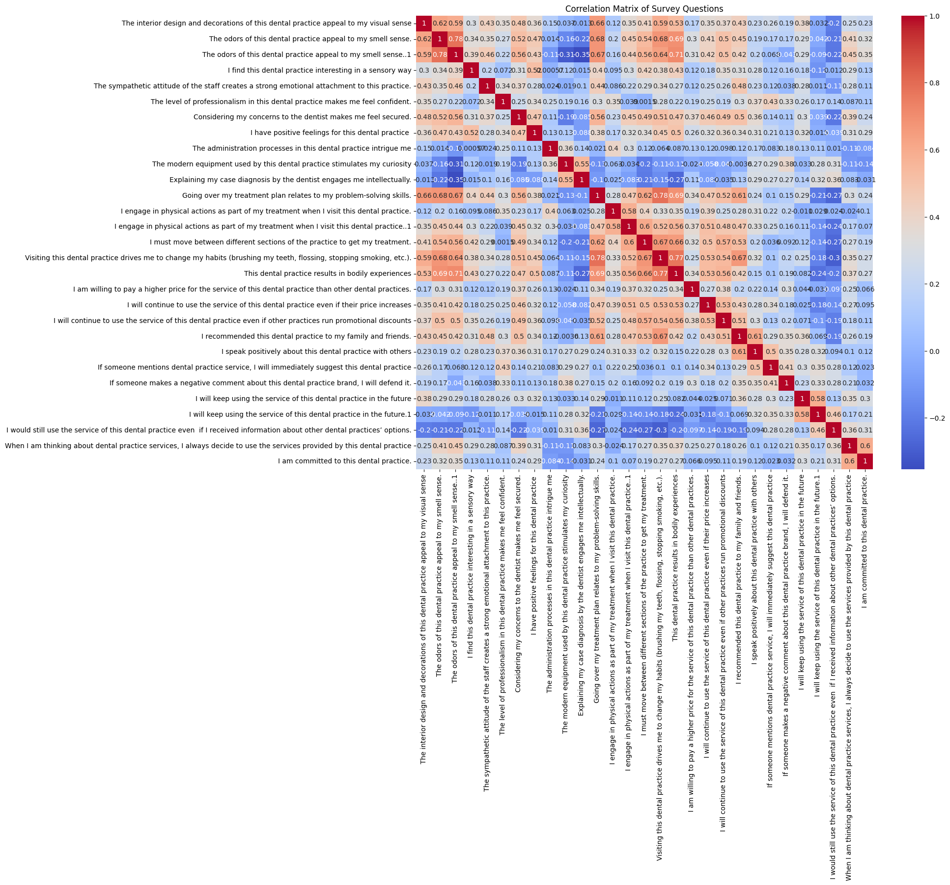
Correlation Matrix of Survey Questions
The correlation matrix displays numerical correlation values between every pair of survey questions.
The diagonal of the matrix contains 1.0, representing each item’s correlation with itself.
The heatmap uses color gradients where warm colors correspond to higher correlation values, and cool colors correspond to lower values.
Each cell in the matrix shows the computed correlation between two specific survey items.
The figure provides a full grid of correlations, showing how all items relate to one another numerically.

Slide 28
visualizations

Slide 29
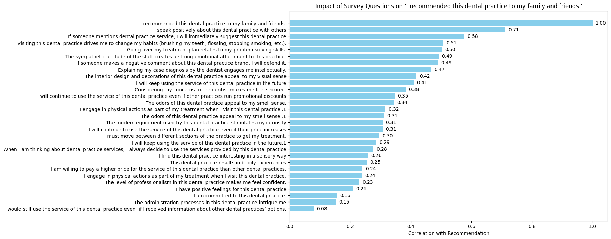
This plot which calculates how strongly each survey question is correlated with the main recommendation question and visualizes the most influential questions using a bar chart.

Slide 30
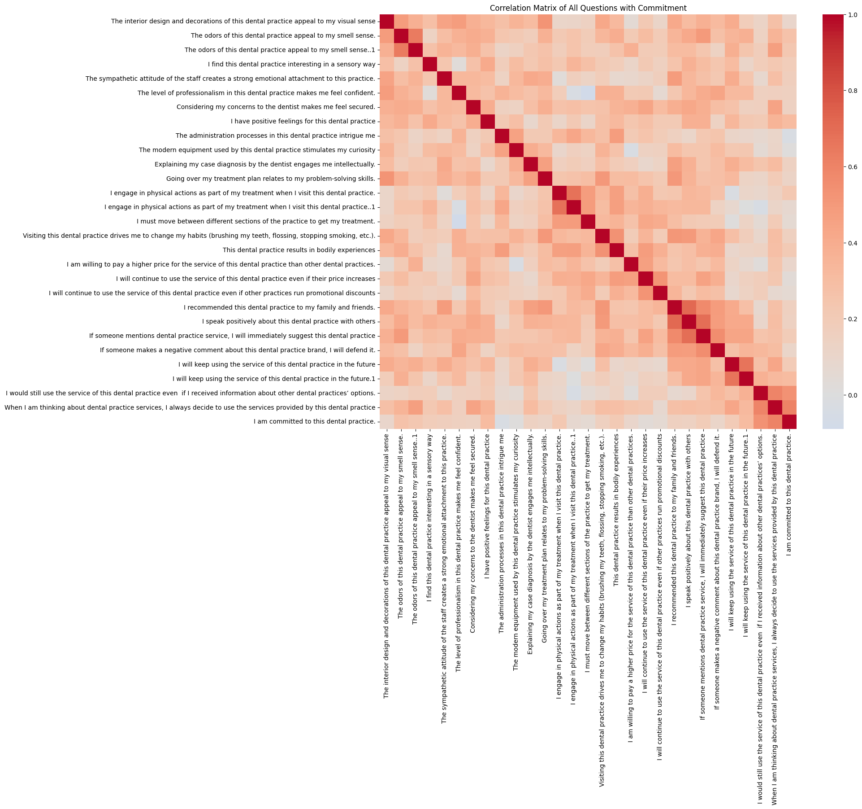
Correlation Matrix of All Questions with Commitment
This plot which calculates correlations among all Likert-scale questions and visualizes them in a heatmap to show how each question relates to the commitment outcome.

Slide 31
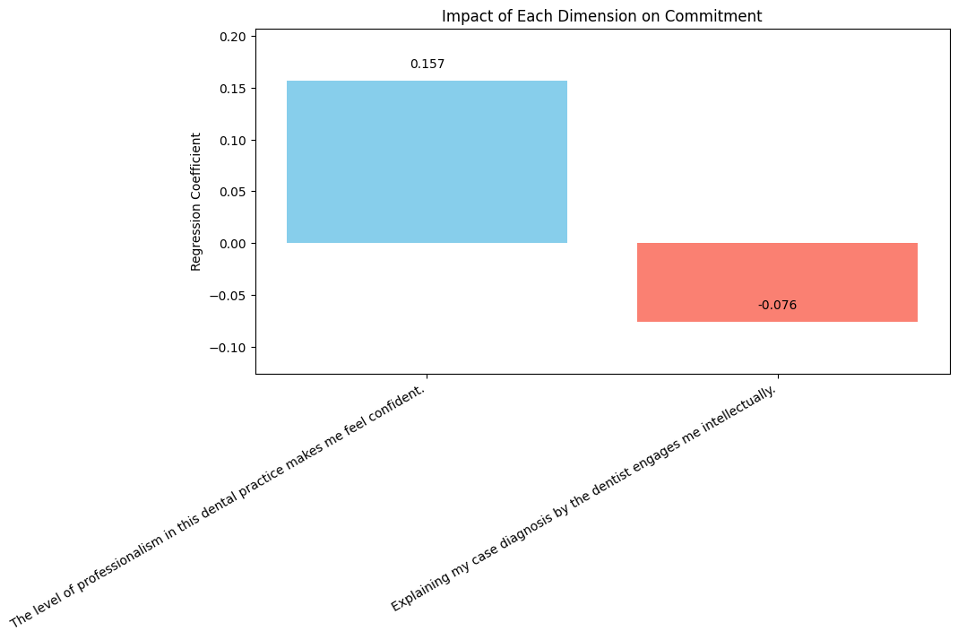
Impact of Each Dimension on Commitment
This plot visualizes the regression coefficients to show how each dimension affects commitment.

Slide 32
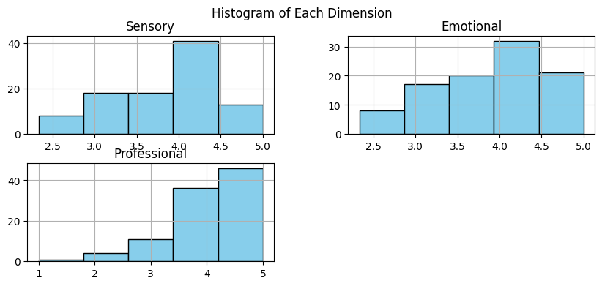
This plots histograms for the Sensory, Emotional, and Professional dimensions to show the distribution of their scores across respondents.

Slide 33
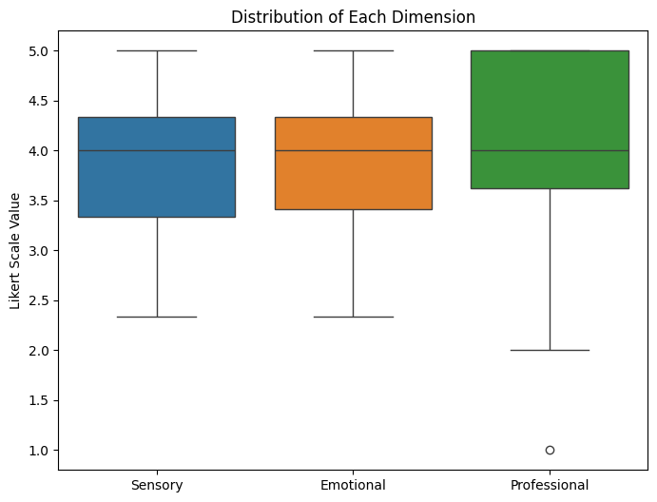
A boxplot for the Sensory, Emotional, and Professional dimensions to visualize their distributions and identify potential outliers.

Slide 34
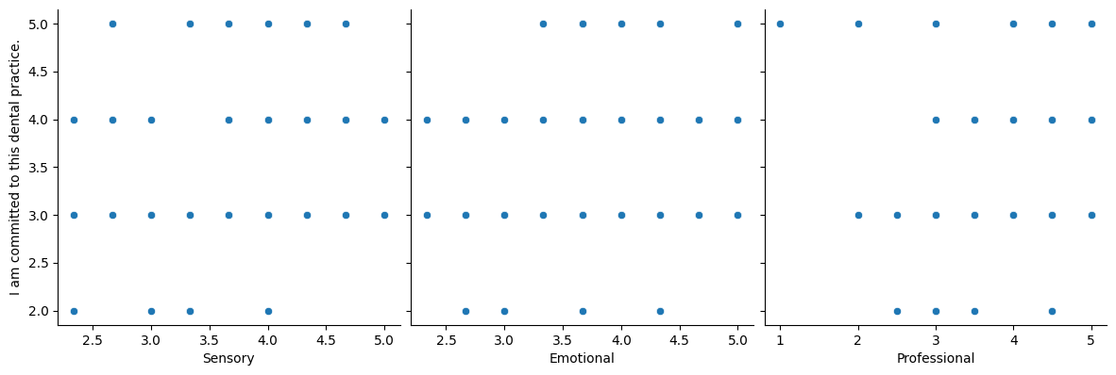
scatter plots of each dimension (Sensory, Emotional, Professional) against the commitment variable to visualize their relationships.

Slide 35
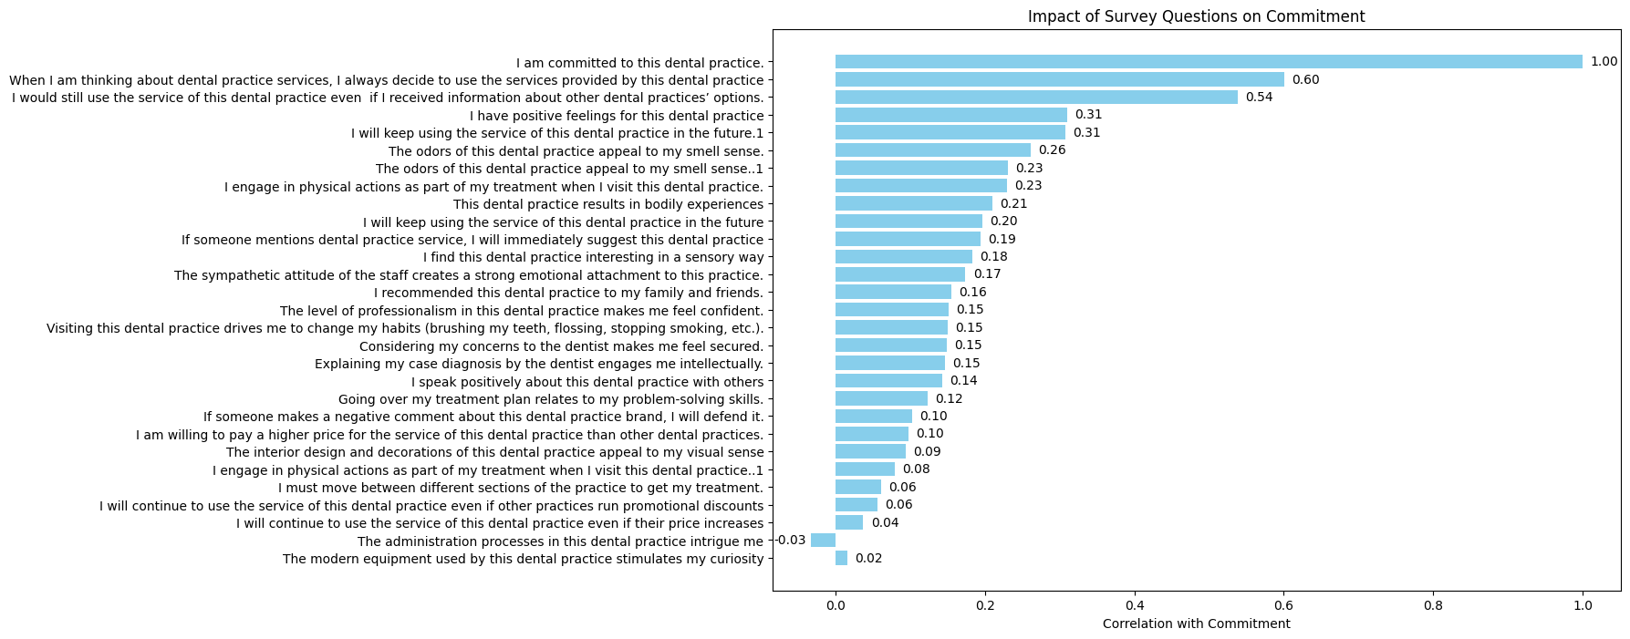
the correlation of each survey question with the commitment variable and visualizes the results as a horizontal bar chart to highlight the most influential questions.

Slide 36
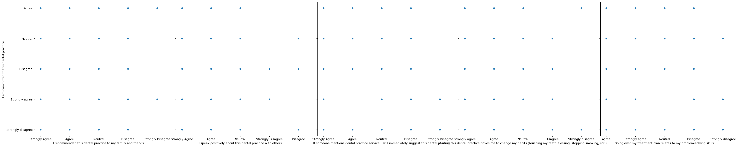
scatter plots for the top 5 questions most correlated with commitment to visually examine their relationships with the commitment variable.

Slide 37
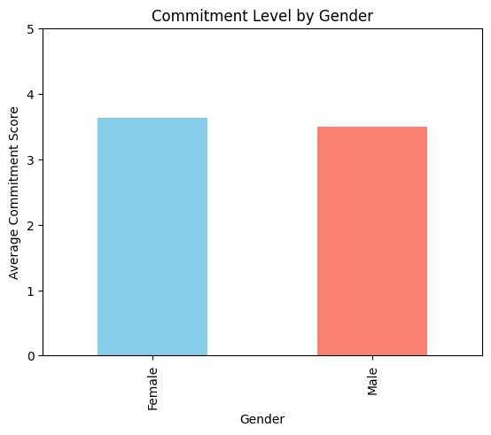
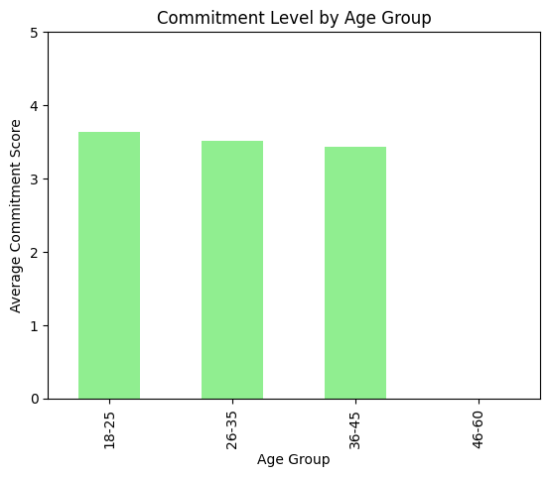
Patients aged 18–25 showed the highest commitment level (3.63), followed by ages 26–35 (3.52). The commitment slightly decreases in the 36–45 group (3.43), and no valid data was available for ages 46–60. This indicates that younger patients tend to be slightly more committed to the dental practice.
Female patients demonstrated a slightly higher commitment level (3.63) compared to male patients (3.50), suggesting that females show marginally stronger loyalty toward the dental practice.

Slide 38
Thank You

